Slide 1

Sprint Five: P.I.E - Pixel Image Editor
Omar Bitar, Product owner•Nick Miller, Scrum Master
Team members: Dustin Shaver•Jacob Watter•Francesco Limoni

Slide 2
Overview
Sprint Five
April 25, 2019
Recent progress
The main features and functions of the PIE app work.
people can use it now.

Slide 3
The Plan
Complete tasks from the previous sprint
Event handling for multi-sized brushes.
Completion of the color wheel.
Bitmap data objects to store image data.
Save methods for popular data file types.
Sprint 5 tasks
fill bucket method.
(optional) advanced fill bucket method.
exporting images.
An HTML document that serves as a help me a guide or tutorial on how to use the "pie" app.

Slide 4
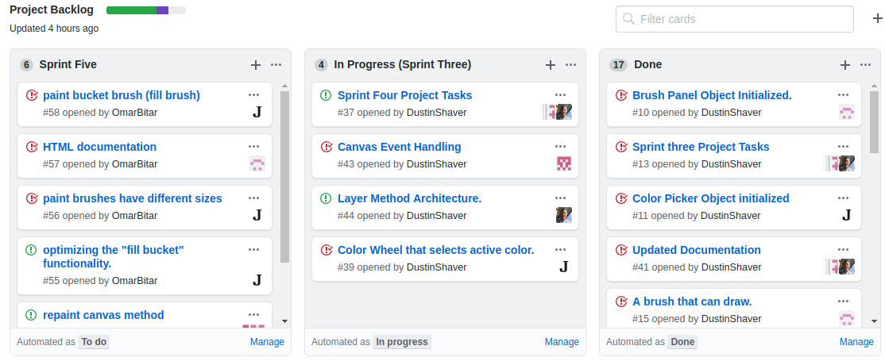
Project Backlog
Completed task
Non-completed task
Our Project Backlog progress : https://github.com/FrancescoLimoni/P.I.E/projects/1

Slide 5
Our Sprint Timeline

Slide 6
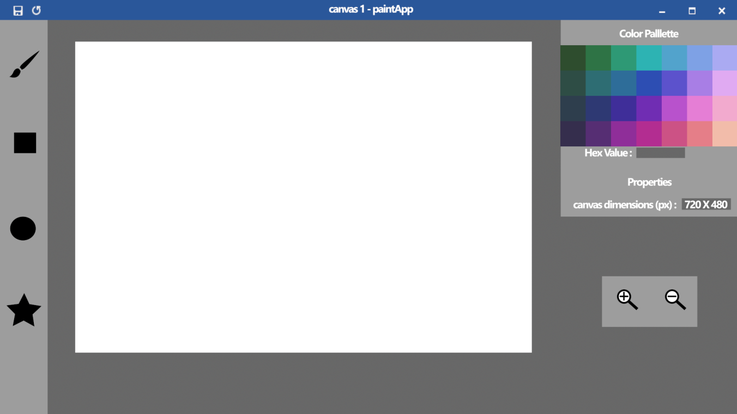
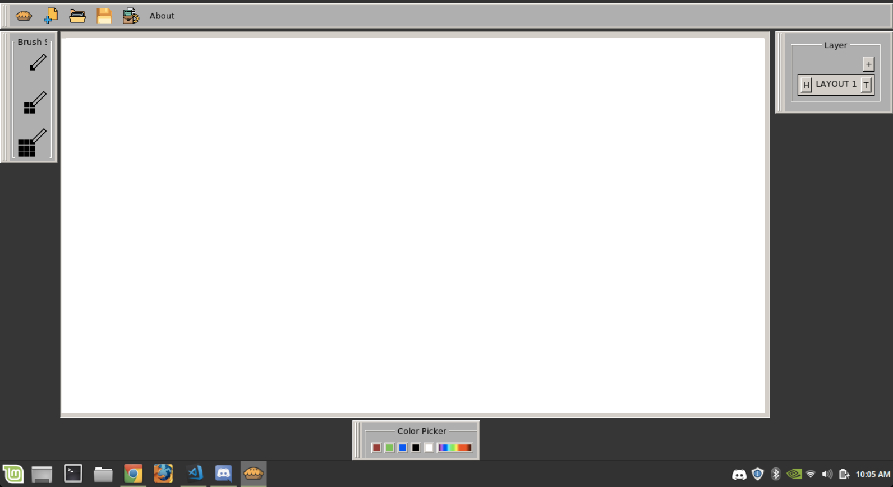
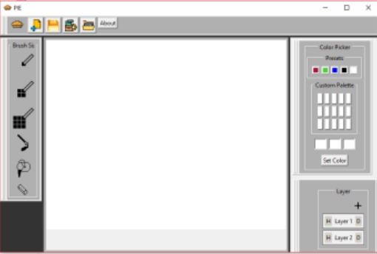
Concept Art
Sprint Two
Sprint Five

Slide 7
For next sprint
A few more features
Optional features
Load
Resize Canvas
Quick save
Layer panel
Color wheel
Advanced fill brush

Slide 8


Our communication process
Discord
GitHub

Slide 9
Time Tracking
Omar Bitar
14
Nick Miller
10
Dustin Shaver Limoni
8
Francesco Limoni
6
Jacob Watters
15

